Slide 1
OC ACM Executive Committee
Format: | Online via Zoom
Zoom Link: | https://acm-org.zoom.us/j/93004927026?pwd=NWRGR0RObUJWZFk5N0NjdFdBMUxEdz09
Date: | January 28, 2026

Slide 2
Agenda
Review of prior meeting minutes
Officers / Volunteers
2026 Chapter Officer Slate
Treasurer’s Report
Recording Discussion
Upcoming Event Preparation
Future Event Planning
Committee Business

Slide 3
Meeting Attendees
Michael Fahy
Allen Takatsuka
Dan Whelan
Marc Velasco
Nilo Niccolai
Winsor Brown
Ansel Teng
Don Choi
Trae Palmer
Raman Rajan
Shirley Tseng
Cynthia Kirkeby
Farhad Mafie
Jared Miller
Kenneth Aguilar
Dawn Childs
Taylor Noh
Stephen Landaas

Slide 4
Motions
Motion | Moved By | Seconded By | Status
Approve November 2025 Executive Committee minutes

Slide 5
Officers
Position | Volunteer
Chair | Taylor Noh
Vice-Chair | Stephen Landaas
Treasurer | Michael Fahy Ph.D.
Secretary | *Need volunteer; Current Fill-in:
Communications | Allen Takatsuka
Webmaster | Stephen Landaas
Program Speaker Coordinator Chair | Jared Miller
SIGAI-OC Liaison | David Harnick-Shapiro

Slide 6
Officers (cont’d)
Position | Volunteer
University Liaison | Michael Fahy Ph.D.
Membership Chair | Farhad Mafie
Program Video Coordinator | *Need volunteer; Current Fill-in:
Social Media Committee | *Need volunteer; Current Fill-in:
Membership Committee | Open
Hospitality | AJ Albrecht
Fundraising Coordinator | Open
Members at Large | A. Winsor Brown, Shirley Tseng, Nilo Niccolai Ph.D., Dan Whelan, Ansel Tseng

Slide 7
2025 Chapter Officer Slate
Position | Current Office Holder | Nominee
Chair | Taylor Noh
Vice-Chair | Stephen Landaas
Treasurer | Michael Fahy Ph.D.
Secretary | Open
Communications | Allen Takatsuka
Webmaster | Stephen Landaas
SIGAI-OC Liaison | David Harnick-Shapiro
Program Speaker Coordinator Chair | Jared Miller

Slide 8
2025 Officer Slate (cont’d)
Position | Current Office Holder | Nominee
University Liaison | Michael Fahy Ph.D.
Membership Chair | Farhad Mafie
Program Video Coordinator | Open
Social Media Committee | Open
Membership Committee | Open
Hospitality | AJ Albrecht
Fundraising Coordinator | Open
Members at Large | A. Winsor Brown, Shirley Tseng, Nilo Niccolai Ph.D., Dan Whelan, Ansel Tseng

Slide 9
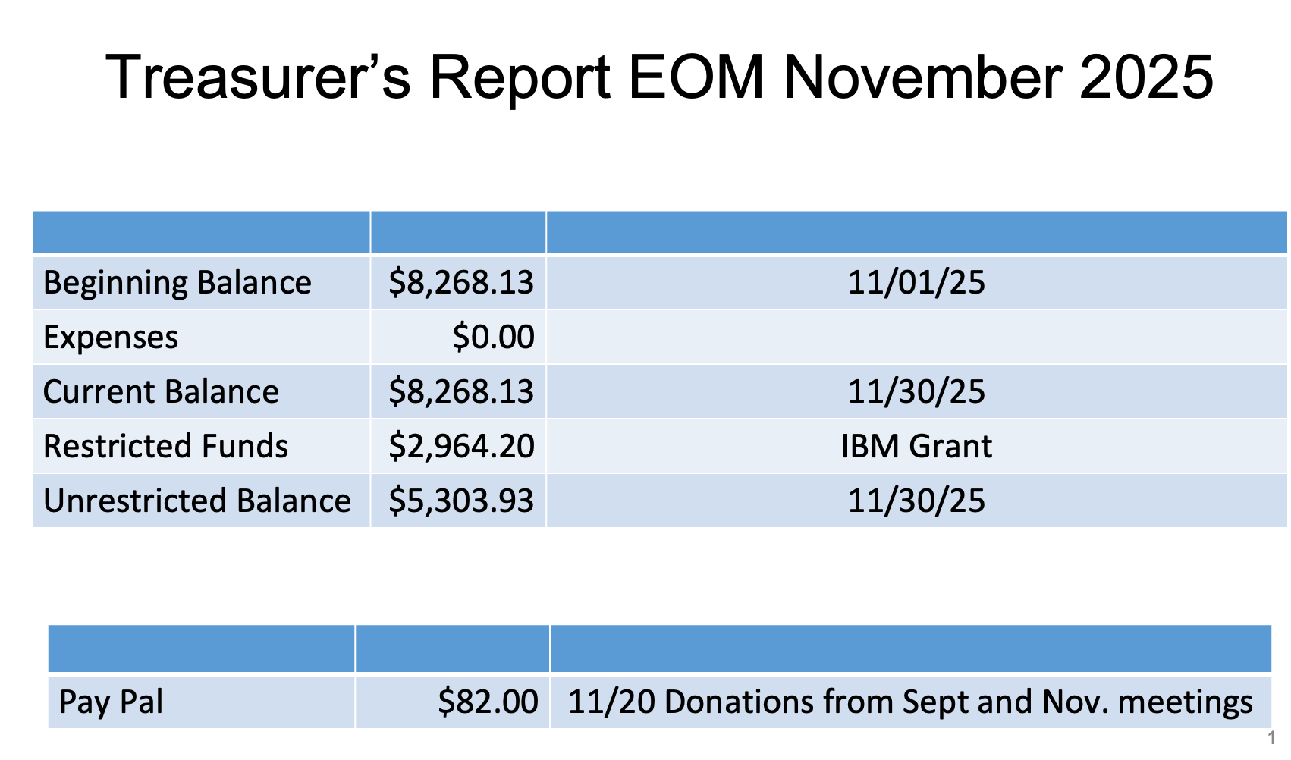

Slide 10
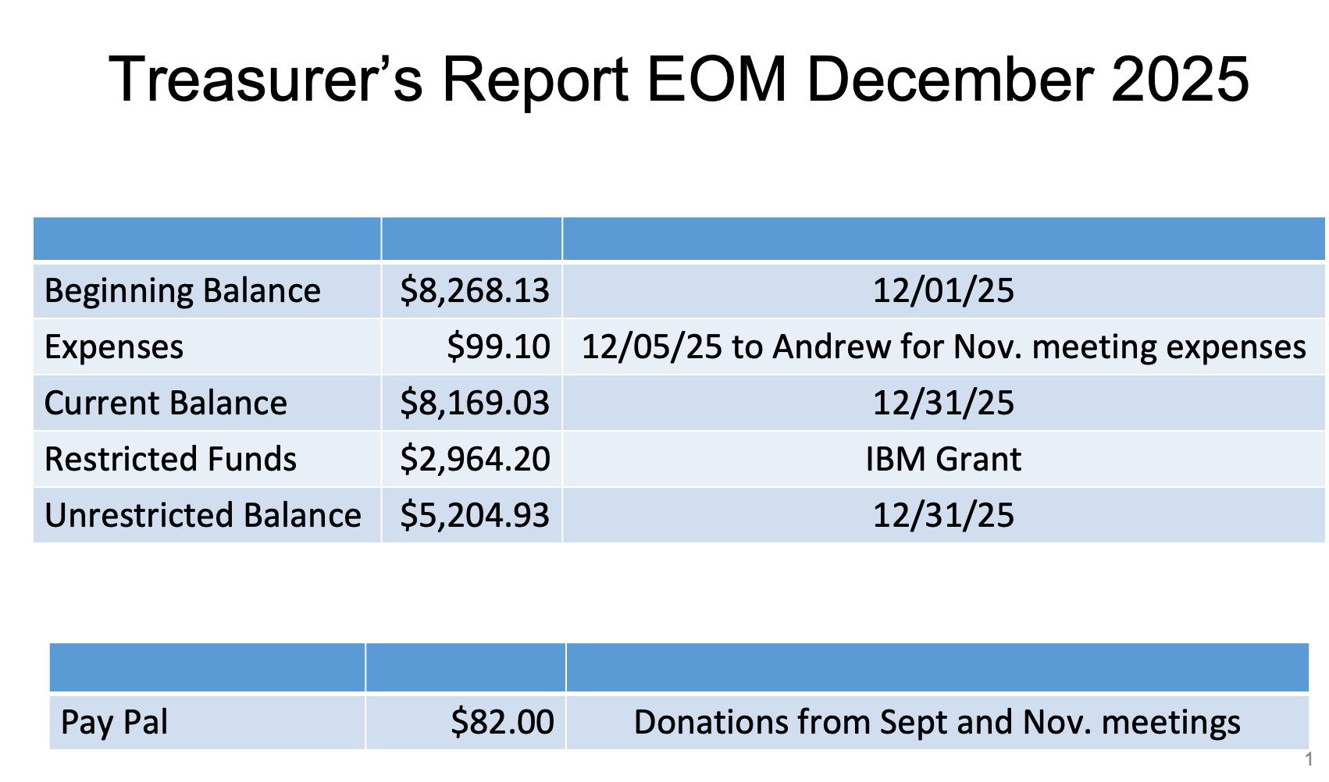

Slide 11
Recording Discussion and Next Steps
Discussion:
Any objections to posting the December recording? If so, what time stamps?
Next Steps:
Establish more rules and protocol on this matter

Slide 12
Upcoming (March) Event Planning

Slide 13
March Speaker Bio
TBD

Slide 14
Proposed Abstract
TBD

Slide 15
Future Program Calendar
Date | Speaker | Talk
3/25/2026
5/20/2026
7/15/2025
9/16/2025
11/18/2025

Slide 16
Future Program Event Candidates (UCI)
Machine Learning
Control Theory & Robotics
System
Theory
Informatics

Slide 17
Future Program Event Candidates
Potential Speakers
Topics

Slide 18
Committee Business
Volunteer Updates
Action Items
Sean Ambrose taking over John King’s role as Knobbe Liaison
Knobbe has the list of 2026 meetings
Finalize March speaker
Promote board position openings through comms, friends, and at next program meeting
Work on next steps regarding December recording
New/Other Business

